Slide 1


Slide 2

Data Science. Week 7. University of Bristol Autumn 2024

Slide 3
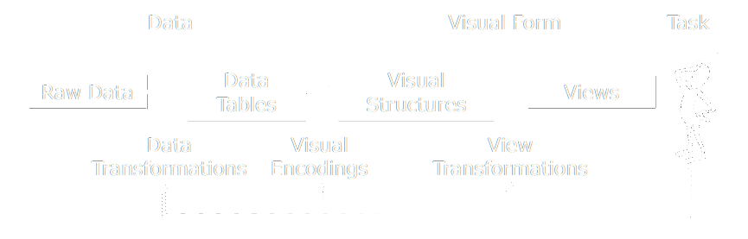
visualisation reference model
Jeffrey Heer, 2018. Adapted from UW CSE442.
Notes:
There is an overload of information.
We need a way to figure out what is important and what is not.

Slide 4
Week 7.
Code-along:
Deeper dive into Vega. Transforms. Layers.
Manipulating data with python and pandas.
Data scraping. Getting data from the (semantic) web.
Notes:
://homes.cs.washington.edu/~jheer//files/zoo/

Slide 5
Data wrangling.
Data sorting in Vega-lite.
https://vega.github.io/vega-lite/docs/sort.html
Layers.
https://vega.github.io/vega-lite/docs/layer.html
Transforms.
https://vega.github.io/vega-lite/docs/transform.html
Expression.
https://vega.github.io/vega/docs/expressions/
Nested data returned by an API. Double/multiple nesting – python only.

Slide 6
Data wrangling questions.
AlphaVantage
ArcGIS
WorldBank
Supercar Index

Slide 7
Scraping.
Not everyone likes it. But it’s (mostly) legal.
Scraping the HTML source. Easy. Automated.
Scraping static HTML pages.
A bit more difficult. Can be automated.
CAPTCHA. Impersonating a human user. Zombie browser.
Scraping HTML pages generated on-the-fly with JavaScript.
Hard. Only zombie browser works, and only in some cases.
hiQ labs vs. LinkedIn, 2019, US Court of Appeals for the Ninth Circuit, 17-16783
LinkedIn vs. hiQ labs, 2021, US Supreme Court, 19-1116
Notes:
https://jaxenter.com/data-scraping-cases-165385.html
https://www.bloomberglaw.com/public/desktop/document/HIQ_Labs_Inc_v_LinkedIn_Corp_No_1716783_2019_BL_336537_9th_Cir_Se?1636358098
https://www.bloomberglaw.com/public/desktop/document/LinkedInCorporationPetitionervshiQLabsIncDocketNo191116USMar12202?1624546490
https://news.bloomberglaw.com/us-law-week/supreme-court-scraps-linkedin-data-scraping-decision
BeautifulSoup
Selenium

Slide 8
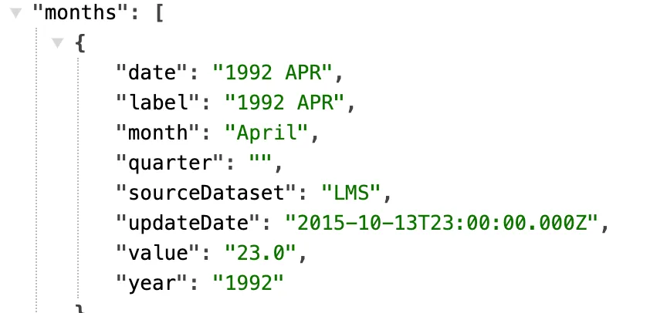
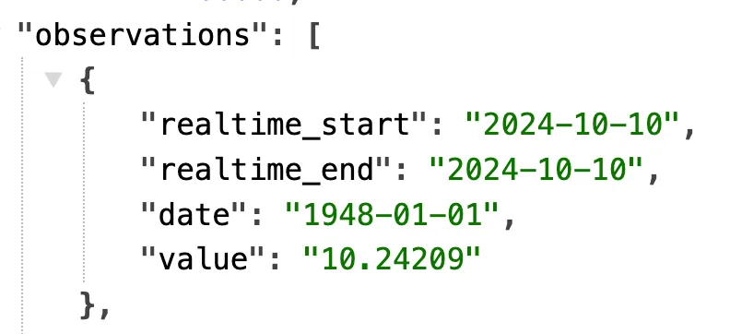
Dates. Working with temporal data
Data sources use a wide variety of date formats.
24th October 2024: 24/10/2024, 10/24/24, 24-10-24, 24 oct 2024, October 24 2024 etc…
The gold standard (ISO 8601):
Format: YYYY-MM-DD (e.g., 2024-10-21)
Time: YYYY-MM-DDThh:mm:ss (e.g., 2024-10-21T14:30:00)
Sortable: Lexicographically sorted dates match chronological order.
Vega-Lite will recognise this and convert it to UNIX timestamps.
ONS API
FRED API

Slide 9
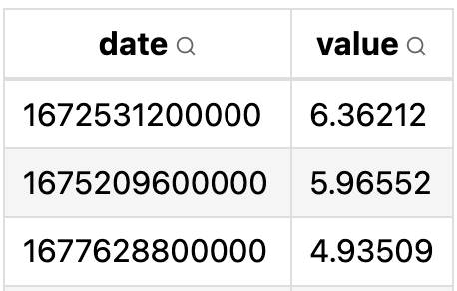
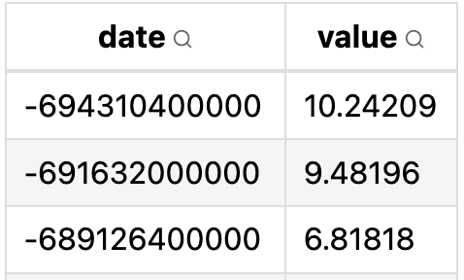
Dates. UNIX timestamps
UNIX Timestamps: Represents the number of seconds (or milliseconds) since the January 1, 1970, 00:00:00 UTC (Unix Epoch).
Negative timestamps count backwards from January 1, 1970.
Why machines use Unix:
Consistency: UNIX timestamps are time zone–agnostic.
Efficiency: Representing dates as numbers allows for faster and more efficient computation.
2023-01-01
1948-01-01
Notes:
https://www.unixtimestamp.com/
UTC: Coordinated Universal Time (UTC)

Slide 10
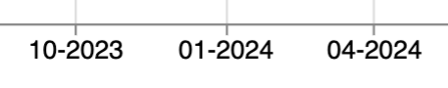
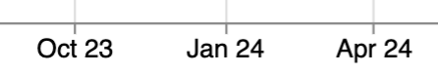
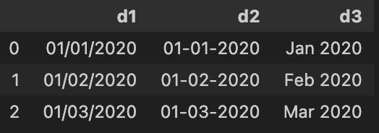
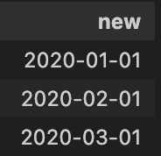
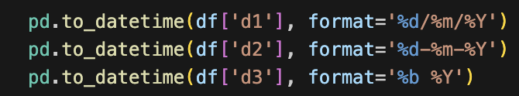
Dates. Formatting
In Vega-Lite:
"axis": {"format": "%m-%Y"}
Often, we want to parse our dates, i.e. change the way they’re stored and displayed.
Vega-Lite: utilises D3 time format pattern.
Date Formatting in D3:
Specifiers: Tokens that represent components of dates and times.
Useful specifiers:
%Y: Four-digit year (2024)
%m: Two-digit month (01–12)
%b: Three-letter month abbreviation (Jan-Dec)
%d: Two-digit day of the month (01–31)
%H: Hour in 24-hour format (00–23)
%M: Minute (00–59)
%S: Second (00–59)
"axis": {"format": "%b %y"}
In Python:
Use pd.to_datetime() to parse columns into the preferred yyyy-mm-dd.

Slide 11
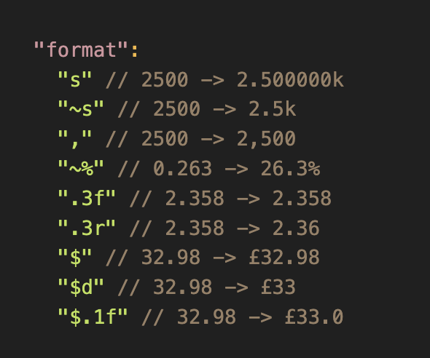
Numbers. Formatting
We can also format quantitative data.
Vega-Lite: utilises D3 number format pattern.
Number formatting in D3:
“~” - trims trailing zeros across all format types
“.” decimal - the decimal point
“,” thousands - the group separator
”$” currency – adds currency prefix
”f”: fixed-point notation
“r”: decimal notation, rounded to significant digits.
“s”: applies SI prefixes (e.g. kilo, mega, giga)
Vega-Lite format property
Note: the order matters

Slide 12
Zeroes. Is it really a 0?
Most datasets will have some missing values.
Some will have 0 values.
There are two different things.
Take care: Excel (for example) will sometimes treat a missing value as a zero.

Slide 13
Three levels of analysis.
Pros, cons and trade-offs.
Basic analysis.
Line, Bar, Area, Pie.
Pros: simple, easy to understand. Work well in 2D.
Cons: hard to draw out relationships.
Advanced analysis.
Scatter, bubble, distributions, de-trended (including univariate regression) shock analysis, Diff-in-Diff.
Pros: allow us to move towards causation, establish relationships. 3D is possible in 2D image by using bubble sizes etc.
Cons: harder to explain.
Complex analysis:
Multivariate Regression, Principal Component Analysis, ML techniques.
Pros: fully interrogate data and establish significant patterns.
Cons: a ‘black box’ - often impossible to chart / visualise.

Slide 14
Advanced charts.
When to use them
Why might we want to go beyond the bar chart, line chart?
Accuracy. Removing noise / volatility.
Comparability. Making series comparable.
Causality. Establishing impact.
Communication. Helping the reader: drawing attention to key findings

Slide 15
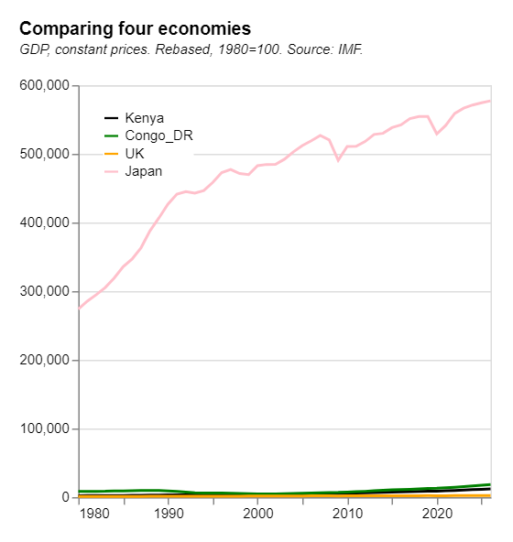
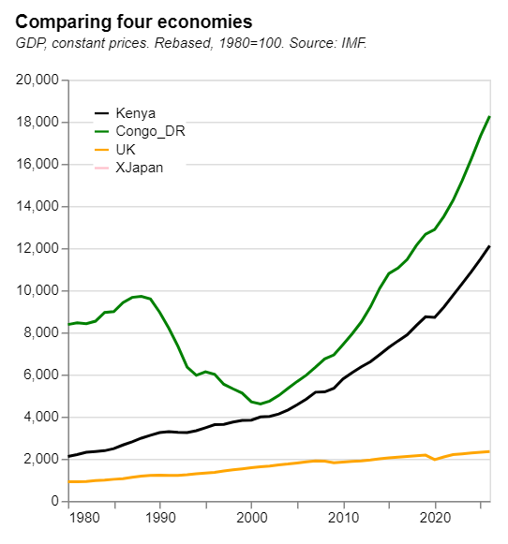
Rebasing.
Problem: sometimes the same data series takes very different values across units of observation

Slide 16
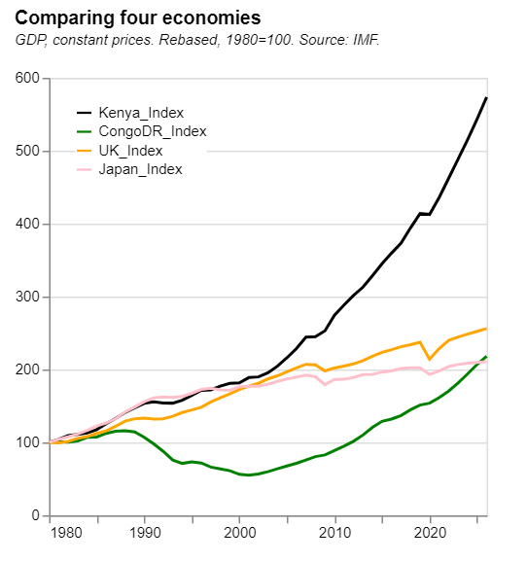
Rebasing.
Solution: rebase so that the data start at the same point (often = 100).
Alternatively, rebase to a point that has some context as an anchor (2008, say).
Vega code.

Slide 17
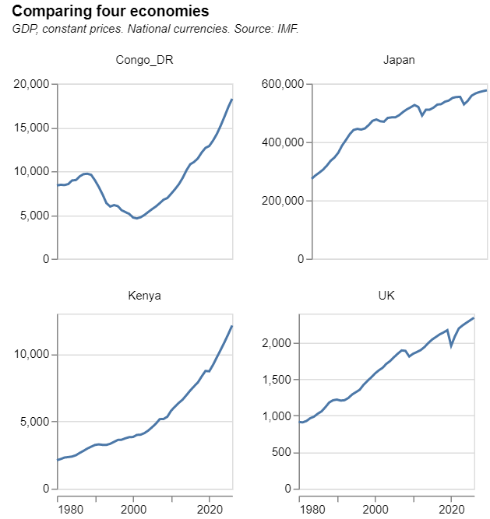
Rebasing - alternative.
There is often no single correct way to visualise data. Here, a Trellis chart does a similar thing…
Vega code.

Slide 18
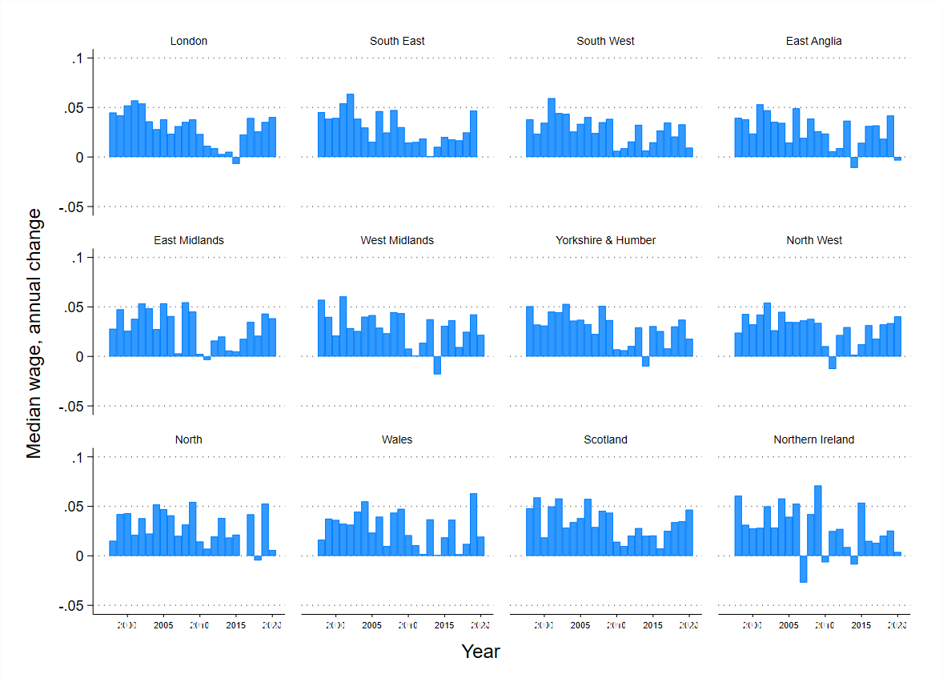
Trellis 1.
Using a trellis to compare data series. The same y axis.

Slide 19
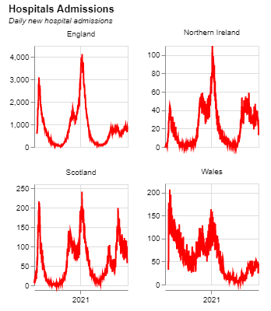
Trellis 2.
Comparing data series with independent y axes.
Vega code.

Slide 20
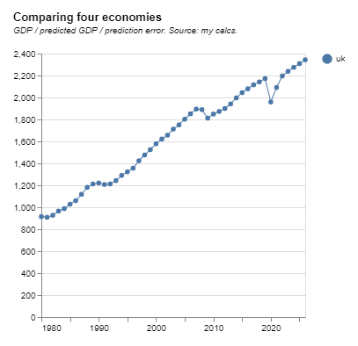
Removing a time trend.
Comparing volatility, or business cycles across countries.

Slide 21
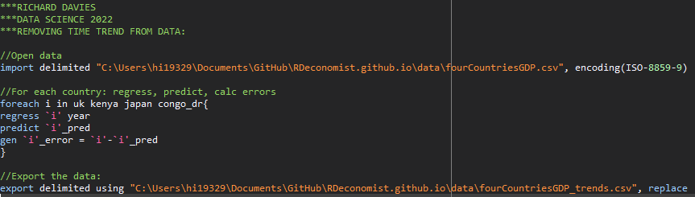
Removing a time trend.
Using a simple OLS regression.
Code for this Stata Do file. Here

Slide 22
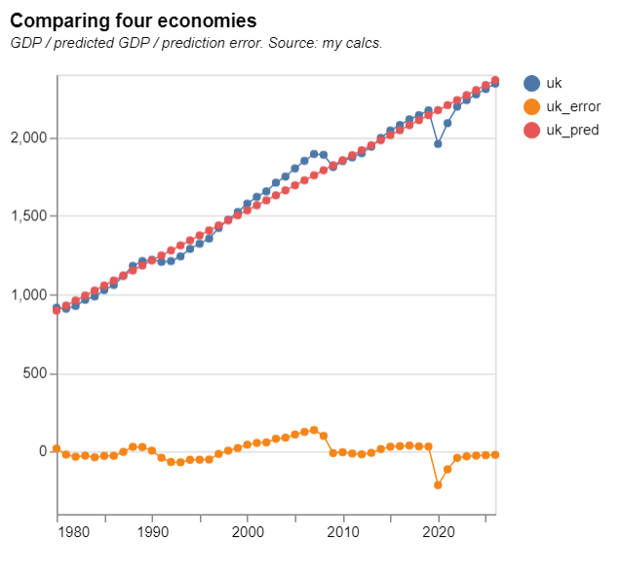
Removing a time trend.
Using a simple OLS regression.

Slide 23
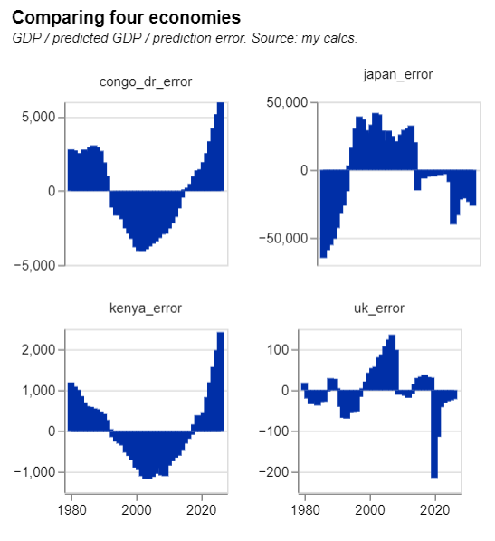
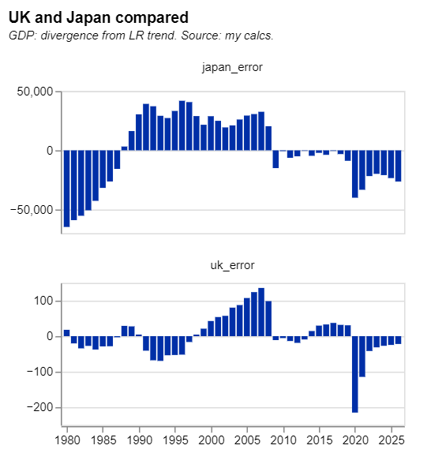
Removing a time trend.
Comparing the deviations from an underlying trend.
Code for these Vega charts: Here

Slide 24
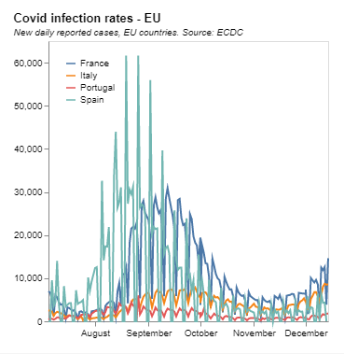
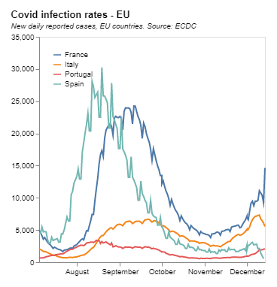
Filtering and smoothing.
Using a moving average (MA)
Vega code

Slide 25
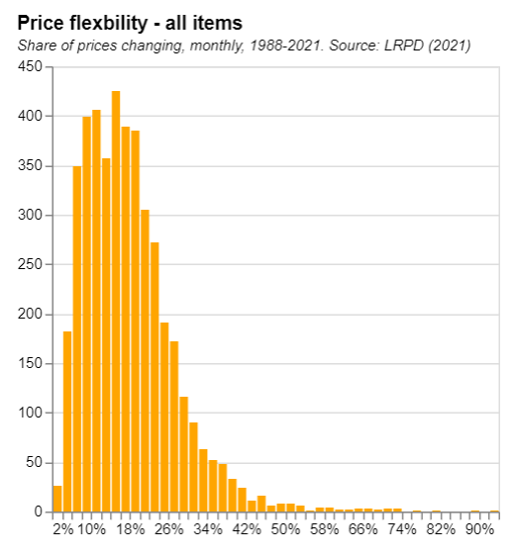
Distributions 1.
Simple histogram

Slide 26
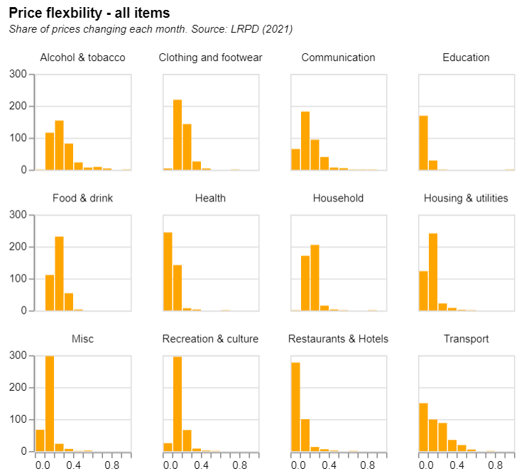
Distributions 2.
Comparing distributions with a trellis

Slide 27
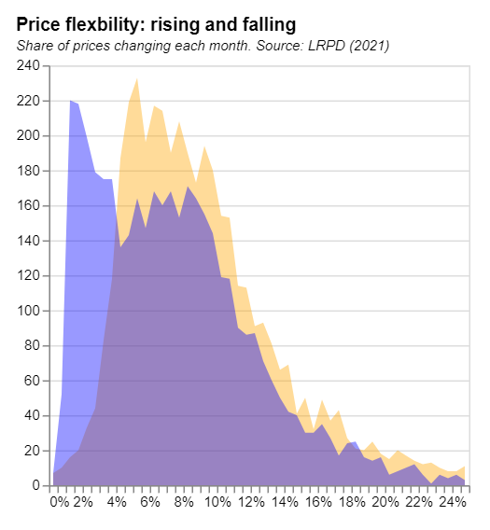
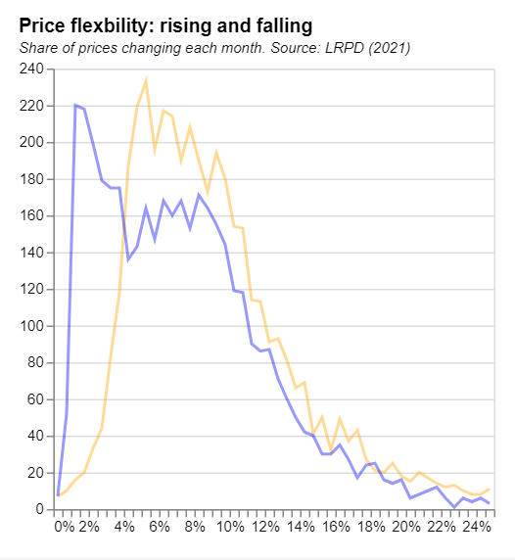
Distributions 3.
Estimating a distribution and comparing on the same chart.

Slide 28
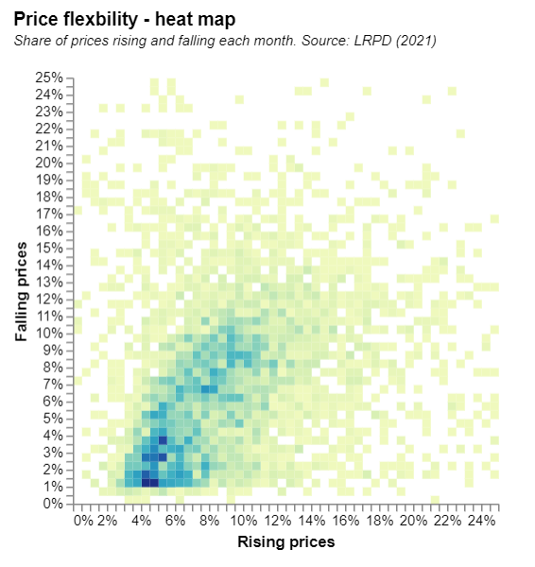
Distributions 4.
Joint distributions – using a heat map.
Code

Slide 29
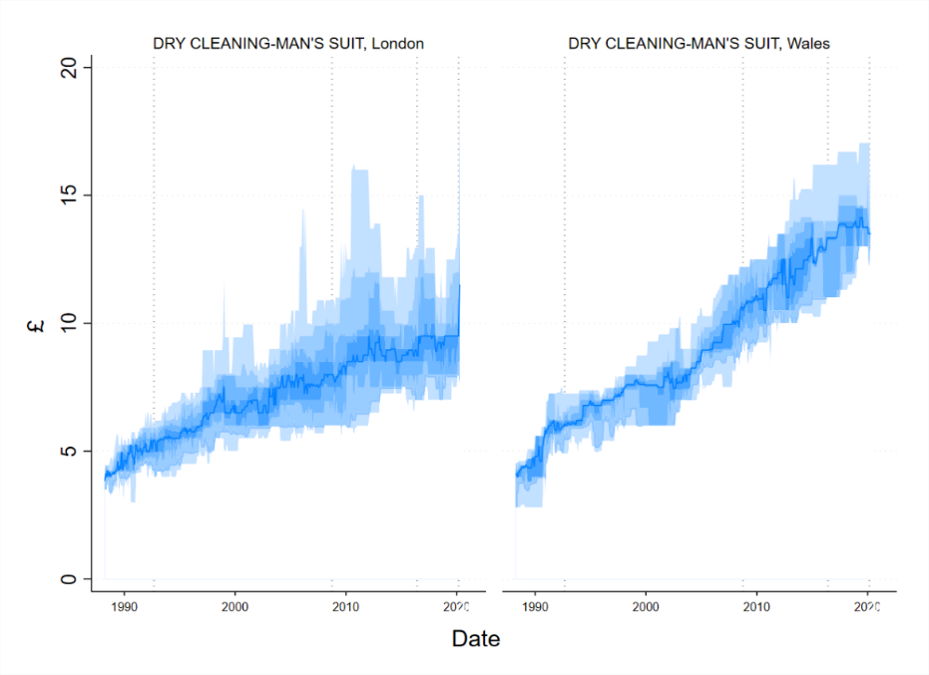
Distributions 5.
Distributions over time, using a swathe or area chart.

Slide 30
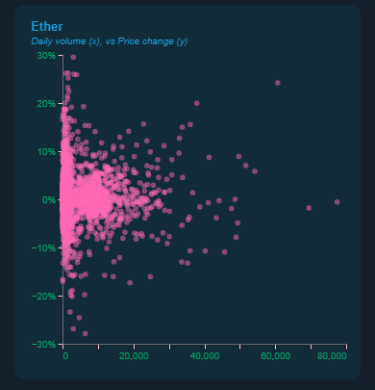
Correlation 1.
Isn’t causation. But it is instructive.

Slide 31
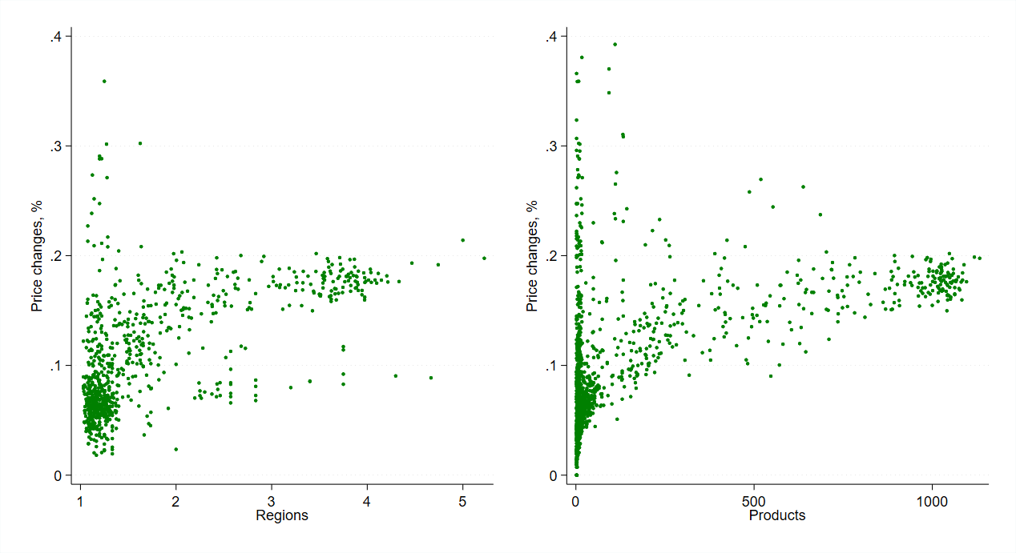
Correlation 2.
Isn’t causation. But it is instructive.

Slide 32
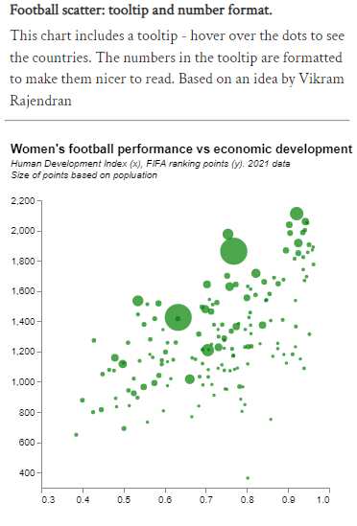
Correlation 3.
Bubble charts.
Code

Slide 33
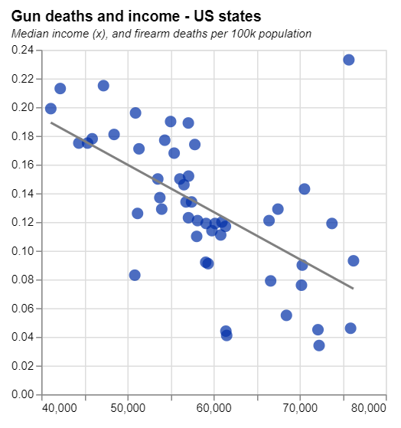
Regression.
Adding lines of best fit to charts.
Code

Slide 34
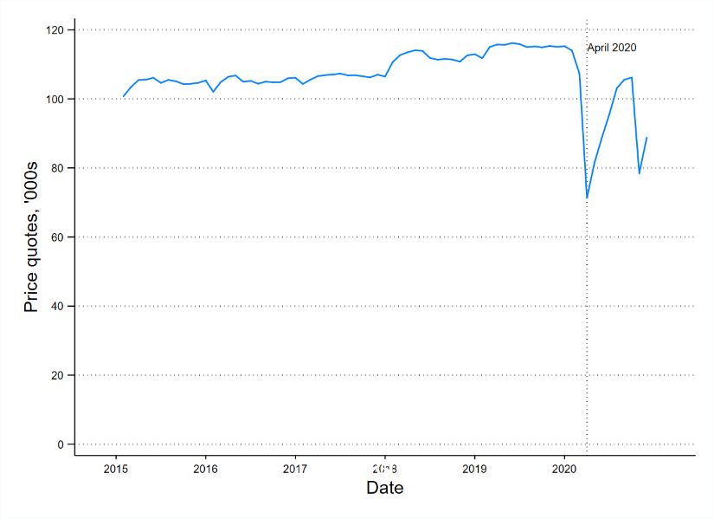
Event studies.
Creating an window around an event

Slide 35
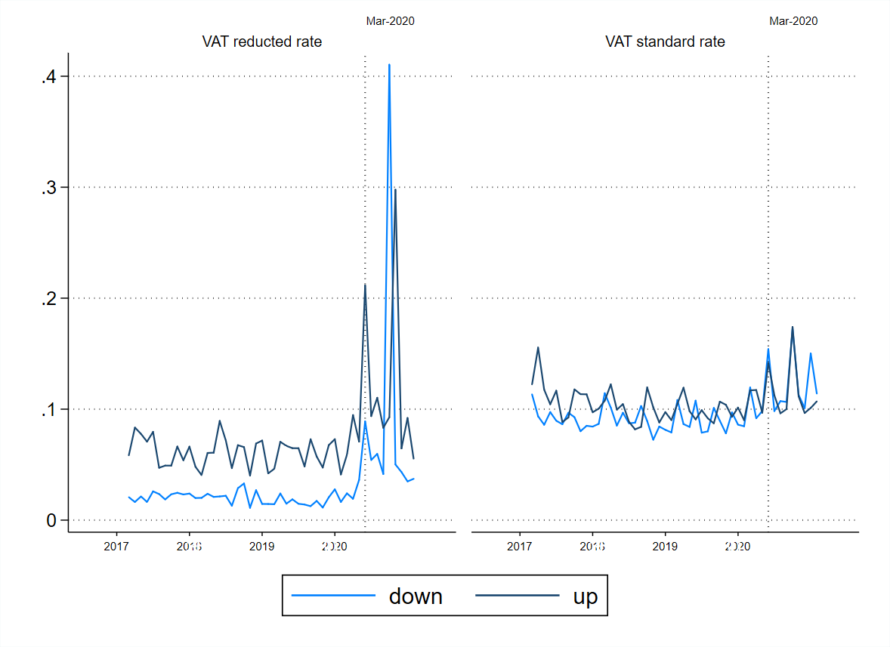
Diff-in-Diff.
Charts motivated by DiD techniques

Slide 36
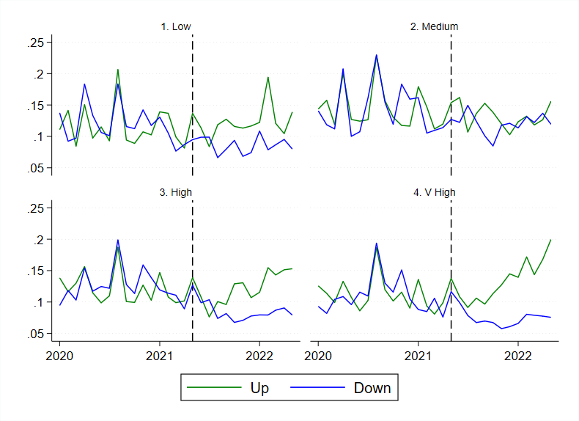
Diff-in-Diff.
Charts motivated by DiD techniques
Notes: Figures show the proportion of prices, analysed at the firm-good-region level, which are rising or falling compared to their previous monthly value. Consumer items are split by EU exposure with low (0-40%), medium (40%-60%), high (60%-80%) and very high (80%+) groupings. Vertical lines are drawn for May 2021.

Slide 37
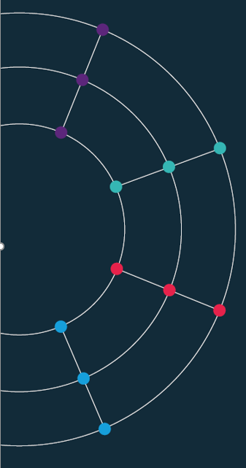
Practical session. Putting it all together.

Slide 38
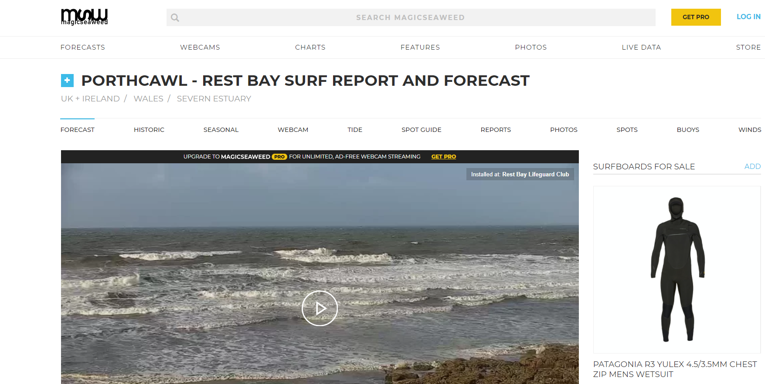
The problem. A clunky and advert-heavy website that I want to browse multiple pages of every day.
https://magicseaweed.com/Porthcawl-Rest-Bay-Surf-Report/1449/

Slide 39
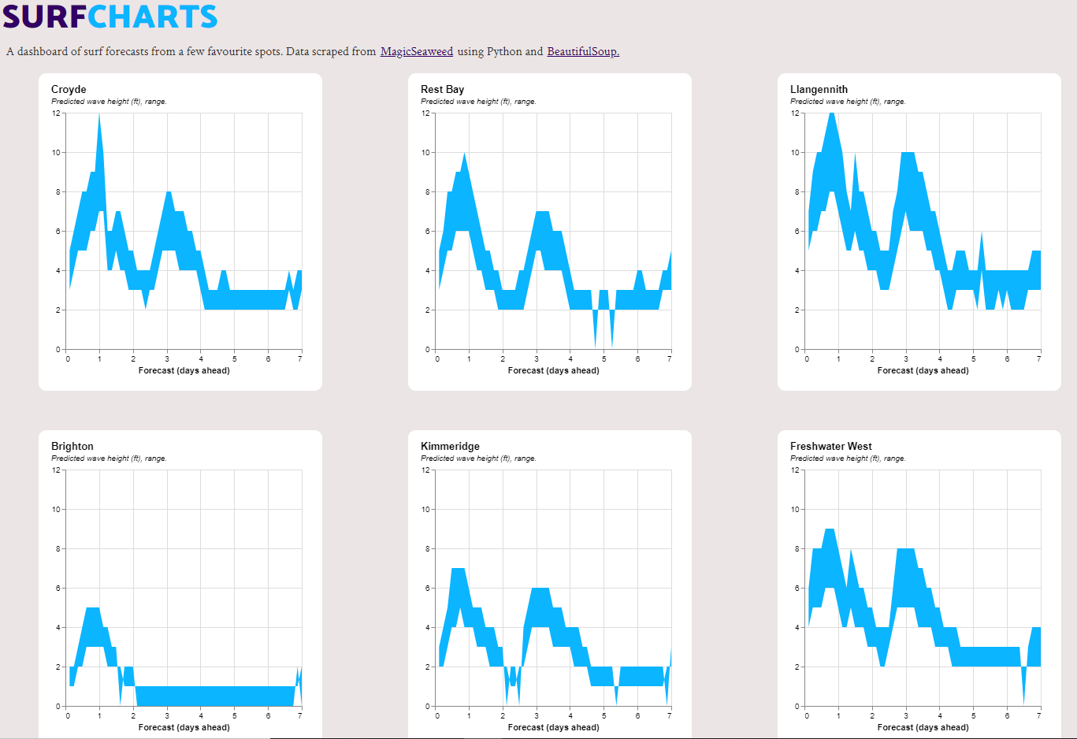
The solution. All the data I want, on one simple clean page.

Slide 40
The plan. Sketching out the steps I want to take.
Open the page, find the data, scrape and save it.
Do the same thing for multiple pages that I am interested in.
Tidy up this data.
Save it to my local computer, and then push it to GitHub
Create a dashboard that runs from this daily scrape.
Save the historical data for longer-run analysis.

Slide 41
The tools. Thinking about the tools and steps that I will need. Problems I may encounter.
Open the page, find the data, scrape and save it.
Beautiful Soup
Do the same thing for multiple pages that I am interested in.
Looping over an array of urls
Tidy up this data.
Data cleaning: Pandas or STATA?
Save it to my local computer, and then push it to GitHub
Python and GitHub integration: can I save myself some clicks?
Create a dashboard that runs from this daily scrape.
HTML, JavaScript, CSS and Vega Lite
Save the historical data for longer-run analysis.
How can I build up my database over time?

Slide 42
The code. All the elements for my Wave Scraper project in one place.
Scraper (Python and STATA):
https://github.com/RDeconomist/RDeconomist.github.io/blob/main/data/waves/waveScraper.do
Data (CSV):
https://github.com/RDeconomist/RDeconomist.github.io/blob/main/data/waves/waveHeights_today.csv
Chart specifications (JSON):
https://github.com/RDeconomist/RDeconomist.github.io/tree/main/charts/surf
Dashboard code (HTML, CSS, JavaScript):
https://github.com/RDeconomist/RDeconomist.github.io/blob/main/surf.html
Live web page:
https://rapidcharts.io/surf

Slide 43
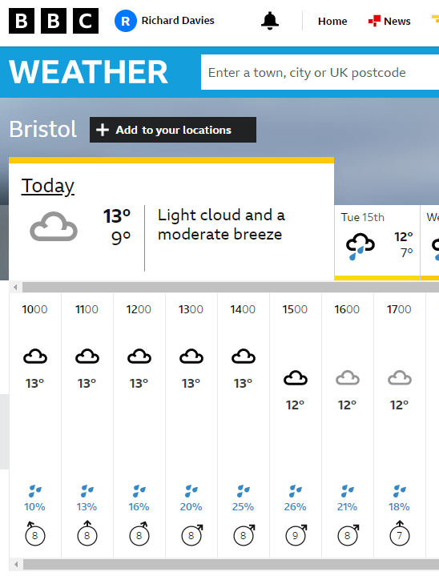
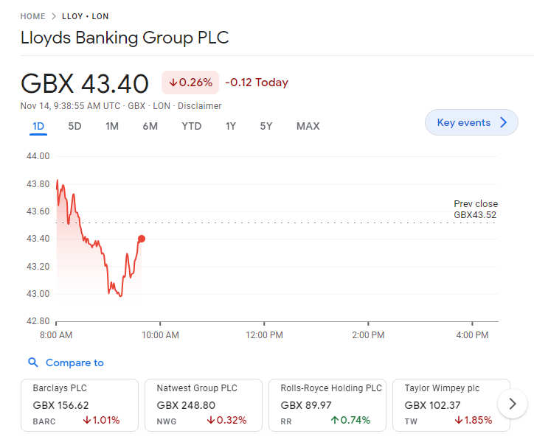
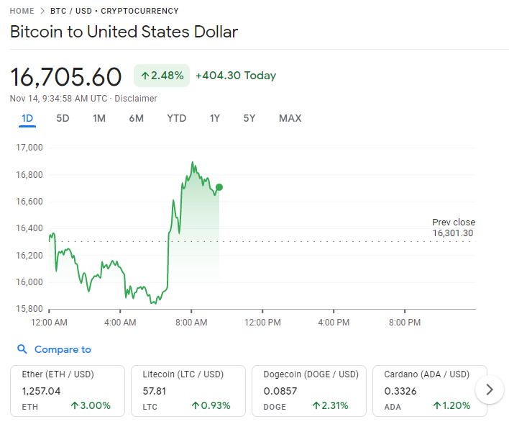

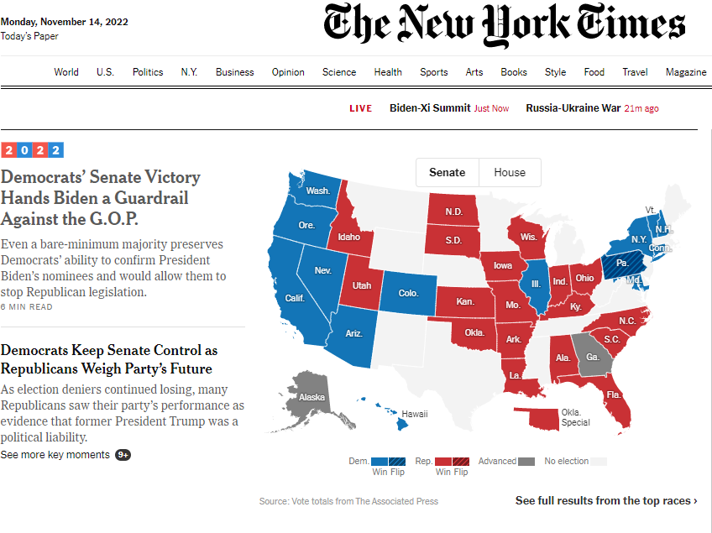
The problem. Attention economy – spend too much time clicking across sites.

Slide 44
The plan. Sketching out the steps I want to take.
Make a single button that will do all this for me.
Ask JavaScript to open all my pages, and grab what I want.
Then show this on a single, simple page.
Some of it as text, some as charts.

Slide 45

The solution. A closed loop. Scraping done on the page, at the click of a button.
https://rapidcharts.io/updateMe
HTML: https://github.com/RDeconomist/RDeconomist.github.io/blob/main/updateMe.html
JS 1: https://github.com/RDeconomist/RDeconomist.github.io/blob/main/js/getMyData.js
JS 2: https://github.com/RDeconomist/RDeconomist.github.io/blob/main/js/getMyNews.js
JS 3: https://github.com/RDeconomist/RDeconomist.github.io/blob/main/js/getMyWeather.js

